Slide 1
Heap sort

Slide 2
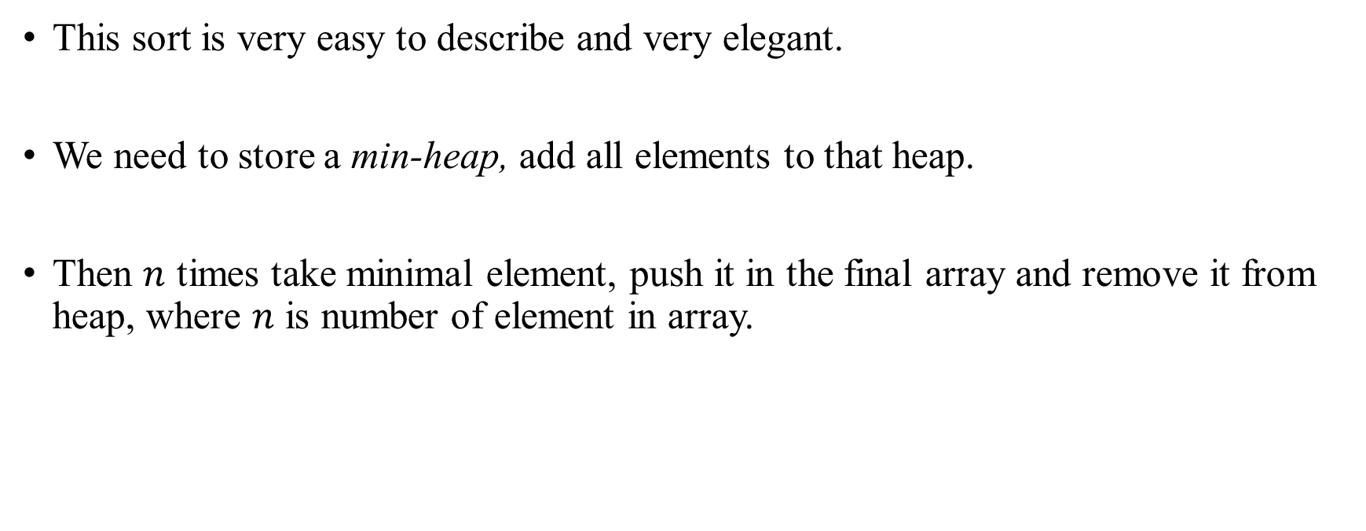
Heap Sort
Idea

Slide 3
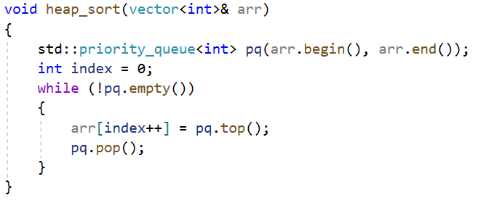
Heap Sort
Implementation

Slide 4
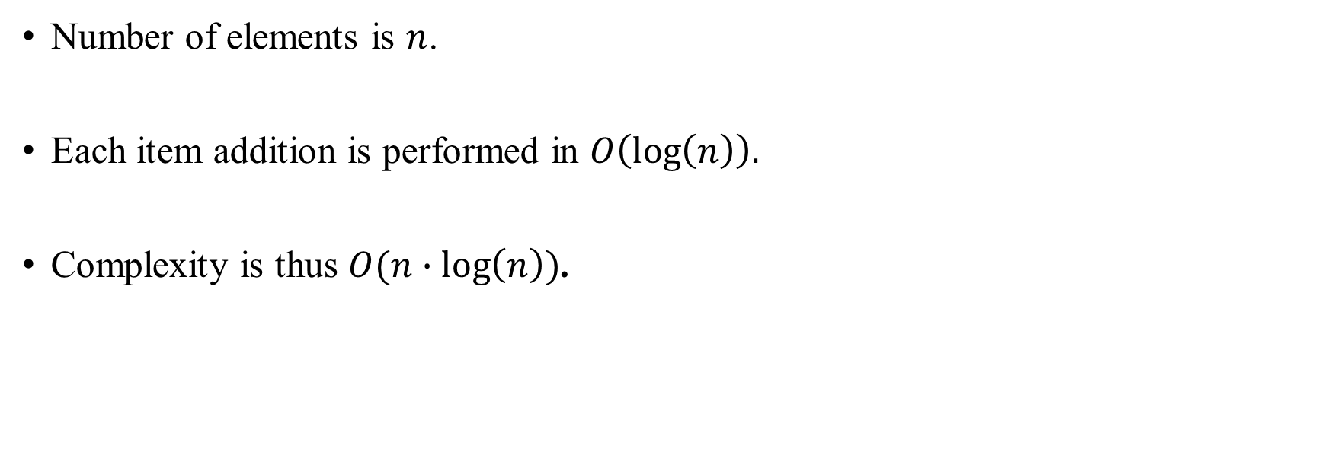
Heap Sort
Analysis

